Slide 1
BIG DATA
What exactly is big data?
The definition of big data is data that contains greater variety, arriving in increasing volumes and with more velocity. This is also known as the three Vs.
Put simply, big data is larger, more complex data sets, especially from new data sources. These data sets are so voluminous that traditional data processing software just can’t manage them. But these massive volumes of data can be used to address business problems you wouldn’t have been able to tackle before.

Slide 2
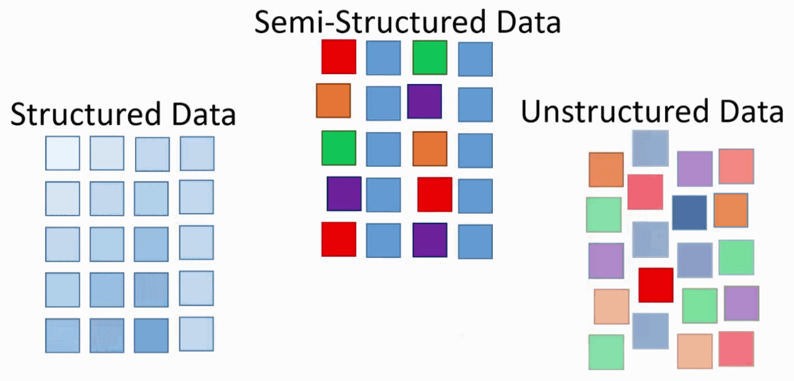
Formats of Big Data
Stuctured
Semi-Structured
Unstuctured

Slide 3
Structured data – Structured data is data whose elements are addressable for effective analysis. It has been organized into a formatted repository that is typically a database. It concerns all data which can be stored in database SQL in a table with rows and columns. They have relational keys and can easily be mapped into pre-designed fields. Today, those data are most processed in the development and simplest way to manage information. Example: Relational data. Semi-Structured data – Semi-structured data is information that does not reside in a relational database but that has some organizational properties that make it easier to analyze. With some processes, you can store them in the relation database (it could be very hard for some kind of semi-structured data), but Semi-structured exist to ease space. Example: XML data. Unstructured data – Unstructured data is a data which is not organized in a predefined manner or does not have a predefined data model, thus it is not a good fit for a mainstream relational database. So for Unstructured data, there are alternative platforms for storing and managing, it is increasingly prevalent in IT systems and is used by organizations in a variety of business intelligence and analytics applications. Example: Word, PDF, Text, Media logs.

Slide 4
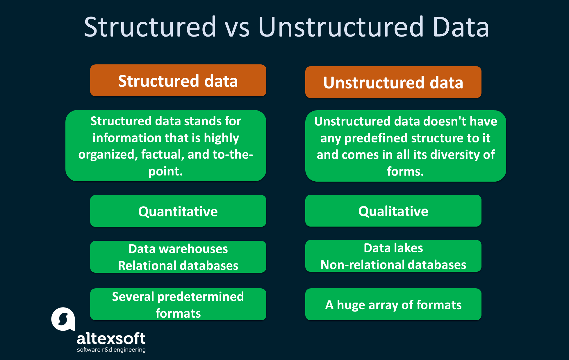

Slide 5
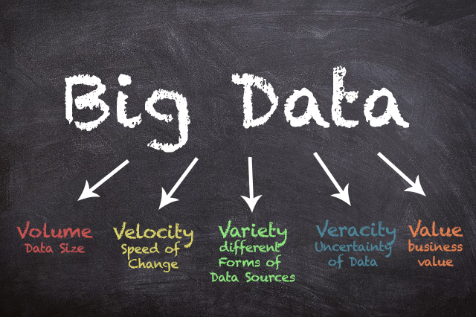
The 5’Vs of big data
VOLUME
VELOCITY
VERACITY
VARIETY
VALUE

Slide 6
Volume:: The amount of data matters. With big data, you’ll have to process high volumes of low-density, unstructured data. This can be data of unknown value, such as Twitter data feeds, clickstreams on a web page or a mobile app, or sensor-enabled equipment. For some organizations, this might be tens of terabytes of data. For others, it may be hundreds of petabytes.
Velocity:: Velocity is the fast rate at which data is received and (perhaps) acted on. Normally, the highest velocity of data streams directly into memory versus being written to disk. Some internet-enabled smart products operate in real time or near real time and will require real-time evaluation and action.
Variety:: Variety refers to the many types of data that are available. Traditional data types were structured and fit neatly in a relational database. With the rise of big data, data comes in new unstructured data types. Unstructured and semistructured data types, such as text, audio, and video, require additional preprocessing to derive meaning and support metadata.

Slide 7
Veracity:: As there are many sources which are contributing to big data , the type of data they are generating is different. It can be structured , semi-structured , unstructured. Hence, there is a variety of data which is getting generated every day. Earlier, we used to get the data from excel and databases , now the data are coming in the form of images, audios, videos, sensor data etc.
Value::: After having the 4 V’s into account there comes one more V which stands for Value!. The bulk of Data having no Value is of no good to the company, unless you turn it into something useful. Data in itself is of no use or importance but it needs to be converted into something valuable to extract Information. Hence, you can state that Value! is the most important V of all the 5V’s.

Slide 8
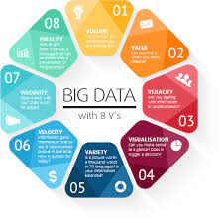

Slide 9
HOW BIG DATA WORKS
Big data gives you new insights that open up new opportunities and business models. Getting started involves three key actions:
1. Integrate::
Big data brings together data from many disparate sources and applications. Traditional data integration mechanisms, such as extract, transform, and load (ETL) generally aren’t up to the task. It requires new strategies and technologies to analyze big data sets at terabyte, or even petabyte, scale.
2. Manage::
Big data requires storage. Your storage solution can be in the cloud, on premises, or both. You can store your data in any form you want and bring your desired processing requirements and necessary process engines to those data sets on an on-demand basis. Many people choose their storage solution according to where their data is currently residing.

Slide 10
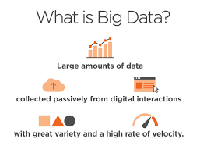
3. Analyze::
Your investment in big data pays off when you analyze and act on your data. Get new clarity with a visual analysis of your varied data sets. Explore the data further to make new discoveries. Share your findings with others. Build data models with machine learning and artificial intelligence. Put your data to work.

Slide 11
